Slide 1
Pipeline Hazards
Notes:
Please if anyone has additional comments please speak up

Slide 2
Pipeline Hazards
Hazards are situations in pipelining where one instruction cannot immediately follow another.
Hazards reduce the ideal speedup gained from pipelining and are classified into three classes:
  Structural hazards: Arise from hardware resource conflicts when the available hardware cannot support all possible combinations of instructions.
  Data hazards: Arise when an instruction depends on the results of a previous instruction in a way that is exposed by the overlapping of instructions in the pipeline
  Control hazards: Arise from the pipelining of conditional branches and other instructions that change the PC
Can always resolve hazards by waiting

Slide 3
Performance of Pipelines with Stalls
Hazards in pipelines may make it necessary to stall the pipeline by one or more cycles and thus degrading performance from the ideal CPI of 1.
CPI pipelined = Ideal CPI + Pipeline stall clock cycles per instruction
If pipelining overhead is ignored and we assume that the stages are perfectly balanced then:
Speedup = CPI unpipelined/(1+Pipeline stall cycles per instruction)
When all instructions take the same number of cycles and is equal to the number of pipeline stages then:
Speedup = Pipeline depth/(1+ Pipeline stall cycles per instruction)

Slide 4
Performance of Pipelines with Stalls
If we think of pipelining as improving the effective clock cycle time, then given the the CPI for the unpipelined machine and the CPI of the ideal pipelined machine = 1, then effective speedup of a pipeline with stalls over the unpipelind case is given by:
Speedup = 1 X Clock cycles unpiplined
1 + Pipeline stall cycles Clock cycle pipelined
When pipe stages are balanced with no overhead, the clock cycle for the pipelined machine is smaller by a factor equal to the pipelined depth:
Clock cycle pipelined = clock cycle unpipelined / pipeline depth
Pipeline depth = Clock cycle unpipelined / clock cycle pipelined
Speedup = 1 X pipeline depth
1 + pipeline stall cycles per instruction

Slide 5
Structural Hazards
In pipelined processors, overlapped instruction execution requires pipelining of functional units and duplication of resources to allow all possible combinations of instructions in the pipeline.
If a resource conflict arises due to a hardware resource being required by more than one instruction in a single cycle, and one or more such instructions cannot be accommodated, then a structural hazard has occurred, for example:
  when a machine has only one register file write port
  or when a pipelined machine has a shared single-memory pipeline for data and instructions.

Slide 6
Register File/Structural Hazards
Operation on register set
by 2 different instructions
in the same clock cycle
Time (clock cycles)
Cycle 1
Cycle 2
Cycle 3
Cycle 4
Cycle 5
Cycle 6
Cycle 7
I
n
s
t
r.
O
r
d
e
r
Load
Ifetch
Reg
ALU
DMem
Reg
Instr 1
Ifetch
Reg
ALU
DMem
Reg
Instr 2
Ifetch
Reg
ALU
DMem
Reg
Instr 3
Ifetch
Reg
ALU
DMem
Reg
Instr 4
Ifetch
Reg
ALU
DMem
Reg

Slide 7
Register File/Structural Hazards
We need 3 stall cycles
In order to solve this hazard
Time (clock cycles)
Cycle 1
Cycle 2
Cycle 3
Cycle 4
Cycle 5
Cycle 6
Cycle 7
I
n
s
t
r.
O
r
d
e
r
Load
Ifetch
Reg
ALU
DMem
Reg
Instr 1
Ifetch
Reg
ALU
DMem
Reg
Instr 2
Ifetch
Reg
ALU
DMem
Reg
Instr 3
Ifetch
Reg
ALU
DMem
Reg
3 stalls cycles
Instr 4
Ifetch
Reg
ALU
DMem
Reg

Slide 8
Register File/Structural Hazards
Allow writing registers in first ½ of cycle and reading in 2nd ½ of cycle
Time (clock cycles)
Cycle 1
Cycle 2
Cycle 3
Cycle 4
Cycle 5
Cycle 6
Cycle 7
No stalls are required
I
n
s
t
r.
O
r
d
e
r
Load
Ifetch
Reg
ALU
DMem
Reg
Instr 1
Ifetch
Reg
ALU
DMem
Reg
Instr 2
Ifetch
Reg
ALU
DMem
Reg
Instr 3
Ifetch
Reg
ALU
DMem
Reg
Instr 4
Ifetch
Reg
ALU
DMem
Reg

Slide 9
1 Memory Port/Structural Hazards
Time (in Cycles)
Operation on Memory
by 2 different instructions
in the same clock cycle
Load
Mem
Reg
ALU
Mem
Reg
Instruction Order
Instruction1
Mem
Reg
ALU
Mem
Reg
Instruction2
Mem
ALU
Mem
Reg
Reg
Instruction3
Mem
ALU
Mem
Reg
Reg
Instruction4
Mem
ALU
Mem
Reg
Reg

Slide 10
Inserting Bubbles (Stalls)
Time (in Cycles)
Load
Mem
Reg
ALU
Mem
Reg
3 stall cycles
with 1-port memory
Instruction1
Mem
Reg
ALU
Mem
Reg
Instruction2
Mem
ALU
Mem
Reg
Reg
Stall
Bubble
Bubble
Bubble
Bubble
Bubble
Stall
Bubble
Bubble
Bubble
Bubble
Bubble
Stall
Bubble
Bubble
Bubble
Bubble
Bubble
Instruction3
Mem
ALU
Mem
Reg
Reg

Slide 11
2 Memory Port/Structural Hazards
(Read & Write at the same time)
Time (in Cycles)
Load
Mem
ALU
Mem
No stall with 2-memory
ports
Reg
Reg
Instruction Order
Instruction1
Mem
Reg
ALU
Mem
Reg
Instruction2
Mem
ALU
Mem
Reg
Reg
Instruction3
Mem
ALU
Mem
Reg
Reg
Instruction4
Mem
ALU
Mem
Reg
Reg

Slide 12

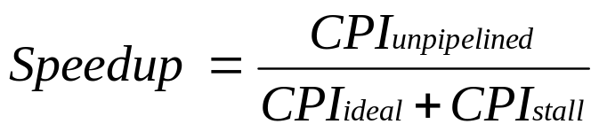
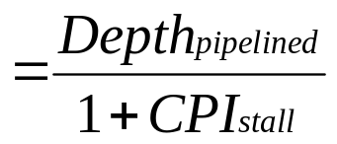
Speed Up Equation for Pipelining
Viewpoint: Decreasing CPI (ignoring the cycle time overhead of pipelining).

Slide 13
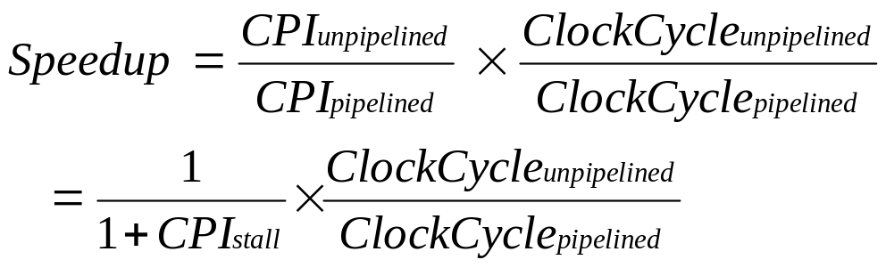
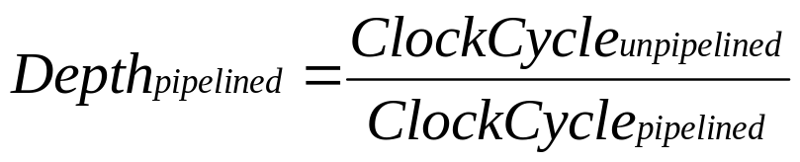
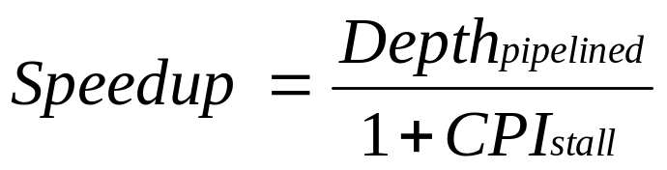
Speed Up Equation for Pipelining
Viewpoint: Improving clock cycle time (CPI_{unpipelined} =1).

Slide 14
Example: Dual-port vs. Single-port Memory
Machine A: Dual ported memory (0 stalls)
Machine B: Single ported memory (3 stalls), but its pipelined implementation has a 1.05 times faster clock rate
Ideal CPI = 1 for both
Loads are 40% of instructions executed
SpeedUp_{A} = Pipeline Depth/(1 + 0) x (clock_{unpipe}/clock_{pipe})
= Pipeline Depth
SpeedUp_{B} = Pipeline Depth/(1 + 0.4 x 3)
x (clock_{unpipe}/(clock_{unpipe} / 1.05)
= (Pipeline Depth/2.2) x 1.05
= 0.48 x Pipeline Depth
SpeedUp_{A} / SpeedUp_{B} = Pipeline Depth/(0.48 x Pipeline Depth) = 2.1
Machine A is 2.1 times faster

Slide 15
Pipeline Hazards
Hazards reduce the ideal speedup gained from pipelining and are classified into three classes:
  Structural hazards: Arise from hardware resource conflicts when the available hardware cannot support all possible combinations of instructions.
  Data hazards: Arise when an instruction depends on the results of a previous instruction in a way that is exposed by the overlapping of instructions in the pipeline
  Control hazards: Arise from the pipelining of conditional branches and other instructions that change the PC
Can always resolve hazards by waiting

Slide 16
Data Hazard on R1
Time (clock cycles)
IF
ID/RF
EX
MEM
WB
I
n
s
t
r.
O
r
d
e
r
add r1,r2,r3
Reg
Ifetch
Reg
ALU
DMem
sub r4,r1,r3
Ifetch
Reg
ALU
DMem
Reg
and r6,r1,r7
Ifetch
Reg
ALU
DMem
Reg
or r8,r1,r9
Ifetch
Reg
ALU
DMem
Reg
xor r10,r1,r11
Ifetch
Reg
ALU
DMem
Reg

Slide 17
Data Hazard Classification
Given two instructions I, J, with I occurring before J in an instruction stream:
RAW (read after write): A true data dependence
J tried to read a source before I writes to it, so J incorrectly gets the old value.
WAW (write after write): A name dependence
J tries to write an operand before it is written by I
The writes end up being performed in the wrong order.
WAR (write after read): A name dependence
J tries to write to a destination before it is read by I,
so I incorrectly gets the new value.
RAR (read after read): Not a hazard.

Slide 18
Data Hazard Classification
I (Write)
I (Read)
Shared
Operand
Shared
Operand
J (Read)
J (Write)
Read after Write (RAW)
Write after Read (WAR)
I (Write)
I (Read)
Shared
Operand
Shared
Operand
J (Write)
J (Read)
Write after Write (WAW)
Read after Read (RAR) not a hazard

Slide 19
Data Hazards Present in Current MIPS Pipeline
Read after Write (RAW) Hazards: Possible?
  Caused by a “Dependence” (in compiler nomenclature). This hazard results from an actual need for communication.
  Yes possible, when an instruction requires an operand generated by a preceding instruction with distance less than four.
  Resolved by:
    Forwarding or Stalling.
I: add r1,r2,r3
J: sub r4,r1,r3
Write
Inst i
1
2
3
4
5
Inst j
1
2
3
4
5
Read
read the old data.

Slide 20
Data Hazards Present in Current MIPS Pipeline
  Write After Read (WAR) – not possible
  Error if Instr_{J} tries to write operand before Instr_{I} reads it
  Called an “anti-dependence” by compiler writers.
  This results from reuse of the name “r1”.
I: sub r4,r1,r3
J: add r1,r2,r3
K: mul r6,r1,r7
Always read the correct data.
Read
Inst i
1
2
3
4
5
Write
Inst j
1
2
3
4
5

Slide 21
Data Hazards Present in Current MIPS Pipeline
  Write After Write (WAW) - not possible
  Error if Instr_{J} tries to write operand before Instr_{I} writes it.
  Called an “output dependence” by compiler writers
  This also results from the reuse of name “r1”.
I: sub r1,r4,r3
J: add r1,r2,r3
K: mul r6,r1,r7
Write
Inst i
1
2
3
4
5
Inst j
1
2
3
4
5
Write

Slide 22
Data Hazards
Solutions for Data Hazards
  Stalling
  Forwarding:
    connect new value directly to next stage
  Reordering

Slide 23
Stalling for Data Hazards
Operation
  First instruction progresses unimpeded
  Second waits in ID until first hits WB (2 stall cycles)
  Third waits in IF until second allowed to progress
IF
ID
EX
M
WB
add r1, 63, r0
r1
add r2, 0, r1
r2
IF
ID
ID
ID
EX
M
WB
r3
IF
IF
IF
ID
EX
M
WB
add r3, 0, r1
r4
IF
ID
EX
M
WB
add r4, 0, r1
r5
IF
ID
EX
M
WB
add r5, 0, r1
r1 written
Time

Slide 24
Minimizing Data Hazard Stalls by Forwarding
Forwarding is a hardware-based technique (also called register bypassing or short-circuiting) used to eliminate or minimize data hazard stalls.
Using forwarding hardware, the result of an instruction is copied directly from where it is produced (ALU, memory read port etc.), to where subsequent instructions need it (ALU, input register, memory write port etc.)
Zero?
MUX MUX
D/A Buffer
A/M Buffer
M/W Buffer
ALU
Data
Memory

Slide 25
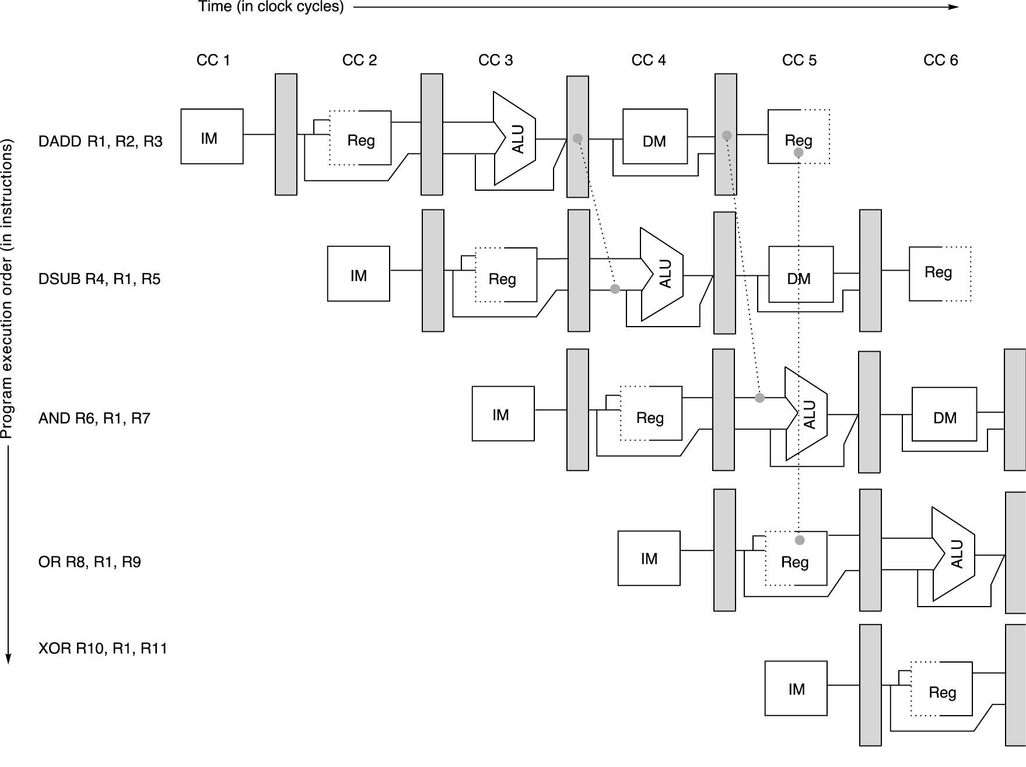
Pipeline with Forwarding:
Could avoid stalls
A set of instructions that depend on the DADD result uses forwarding paths to avoid the data hazard

Slide 26
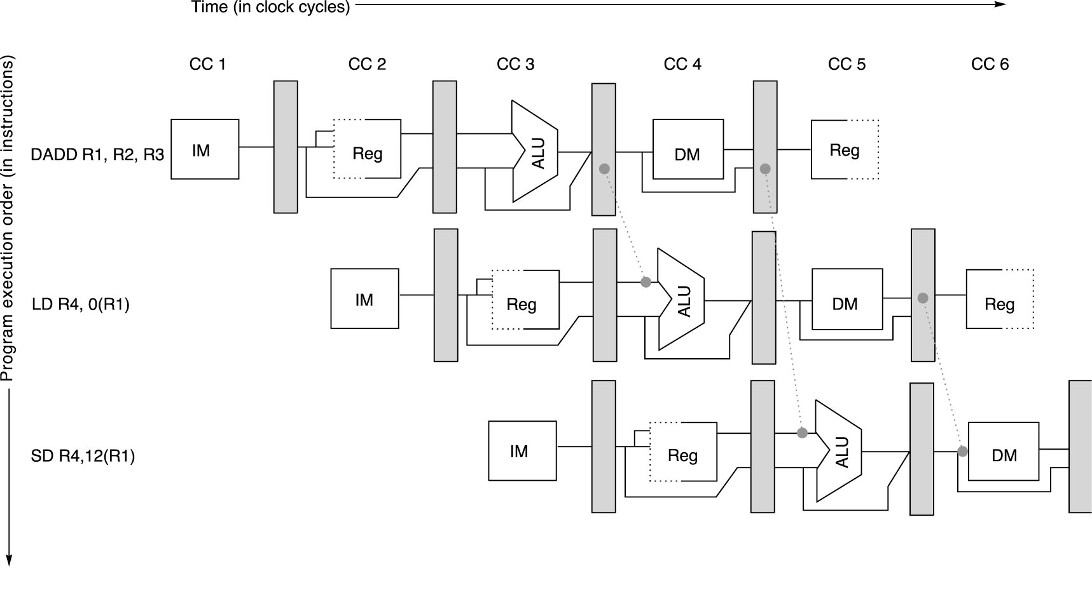
Load/Store Forwarding Example
Forwarding of operand required by stores during MEM

Slide 27
Data Hazards Requiring Stall Cycles
In some code sequence cases, potential data hazards cannot be handled by bypassing. For example:
LD R1, 0 (R2)
DSUB R4, R1, R5
AND R6, R1, R7
OR R8, R1, R9
The LD (load double word) instruction has the data in clock cycle 4 (MEM cycle).
The DSUB instruction needs the data of R1 in the beginning of that cycle.
Hazard prevented by hardware pipeline interlock causing a stall cycle.

Slide 28
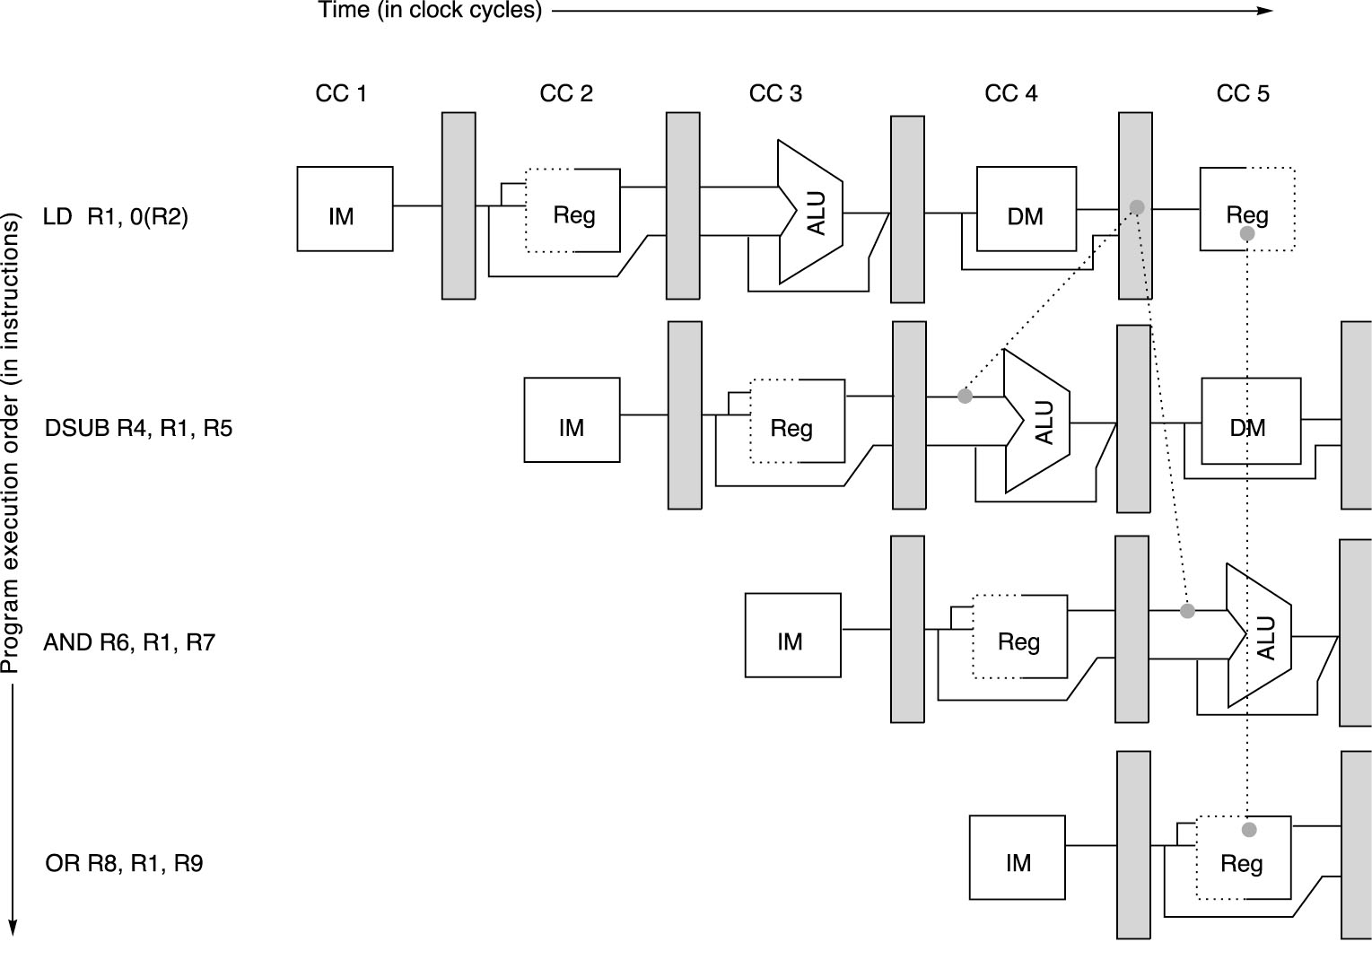

Slide 29
Compiler Instruction Scheduling Example
For the code sequence:
a = b + c
d = e - f
Assuming loads have a latency of one clock cycle, the following code or pipeline compiler schedule eliminates stalls:
a, b, c, d ,e, and f
are in memory
Original code with stalls:
LD Rb,b
LD Rc,c
DADD Ra,Rb,Rc
SD Ra,a
LD Re,e
LD Rf,f
DSUB Rd,Re,Rf
SD Rd,d
Scheduled code with no stalls:
LD Rb,b
LD Rc,c
LD Re,e
DADD Ra,Rb,Rc
LD Rf,f
SD Ra,a
DSUB Rd,Re,Rf
SD Rd,d
Stall
Stall

Slide 30
Control Hazards
A control hazard is when we need to find the destination of a branch, and can’t fetch any new instructions until we know that destination.
A branch is either
  Taken: PC <= PC + 4 + Immediate
  Not Taken: PC <= PC + 4

Slide 31
Control Hazards
When a conditional branch is executed it may change the PC and, without any special measures, leads to stalling the pipeline for a number of cycles until the branch condition is known.
In current MIPS pipeline, the conditional branch is resolved in the MEM stage resulting in three stall cycles as shown below:
Branch instruction IF ID EX MEM WB
Branch successor IF stall stall IF ID EX MEM WB
Branch successor + 1 IF ID EX MEM WB
Branch successor + 2 IF ID EX MEM
Branch successor + 3 IF ID EX
Branch successor + 4 IF ID
Branch successor + 5 IF
Three clock cycles are wasted for every branch for current MIPS pipeline

Slide 32
Control Hazard on Branches
Three Stage Stall
If CPI = 1, 30% branch, Stall 3 cycles ==> new CPI = 1.9!
10: beq r1,r3,36
Ifetch
Reg
ALU
DMem
Reg
14: and r2,r3,r5
Ifetch
Reg
ALU
DMem
Reg
18: or r6,r1,r7
Ifetch
Reg
ALU
DMem
Reg
22: add r8,r1,r9
Ifetch
Reg
ALU
DMem
Reg
36: xor r10,r1,r11
Ifetch
Reg
ALU
DMem
Reg

Slide 33
Reducing Branch Stall Cycles
Pipeline hardware measures to reduce branch stall cycles:
1- Find out whether a branch is taken earlier in the pipeline.
2- Compute the taken PC earlier in the pipeline.
In MIPS:
  In MIPS branch instructions BEQZ, BNE, test a register for equality to zero.
  This can be completed in the ID cycle by moving the zero test into that cycle.
  Both PCs (taken and not taken) must be computed early.
  Requires an additional adder because the current ALU is not useable until EX cycle.
  This results in just a single cycle stall on branches.

Slide 34
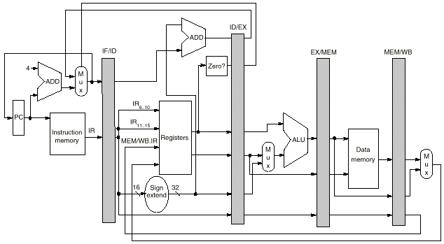
Modified MIPS Pipeline:
Conditional Branches
Completed in ID Stage

Slide 35
Compile-Time Reduction of Branch Penalties
One scheme is to flush or freeze the pipeline whenever a conditional branch is decoded by holding or deleting any instructions in the pipeline until the branch destination is known (zero pipeline registers, control lines).
Another method is to predict that the branch is not taken where the state of the machine is not changed until the branch outcome is definitely known. Execution here continues with the next instruction; stall occurs here when the branch is taken.
Another method is to predict that the branch is taken and begin fetching and executing at the target; stall occurs here if the branch is not taken.

Slide 36
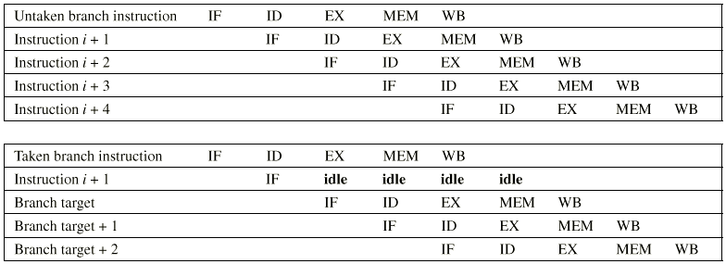
Predict Branch Not-Taken Scheme

Slide 37
Static Compiler Branch Prediction
Two basic methods exist to statically predict branches at compile time:
By examination of program behavior and the use of information collected from earlier runs of the program.
  For example, a program profile may show that most forward branches and backward branches (often forming loops) are taken. The simplest scheme in this case is to just predict the branch as taken.
To predict branches on the basis of branch direction, choosing backward branches (loop) as taken and forward branches (if) as not taken.

Slide 38
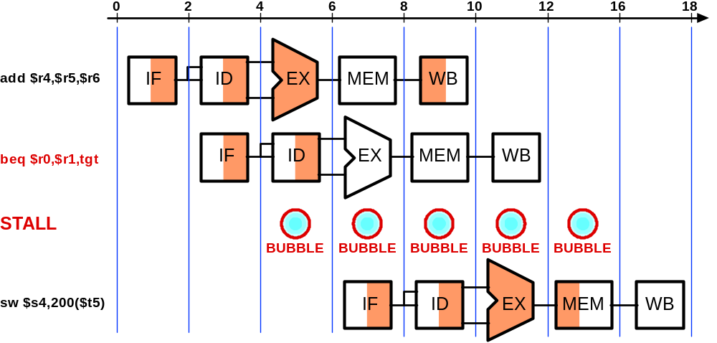
Control Hazard - Stall
beq
writes PC
here
new PC
used here

Slide 39
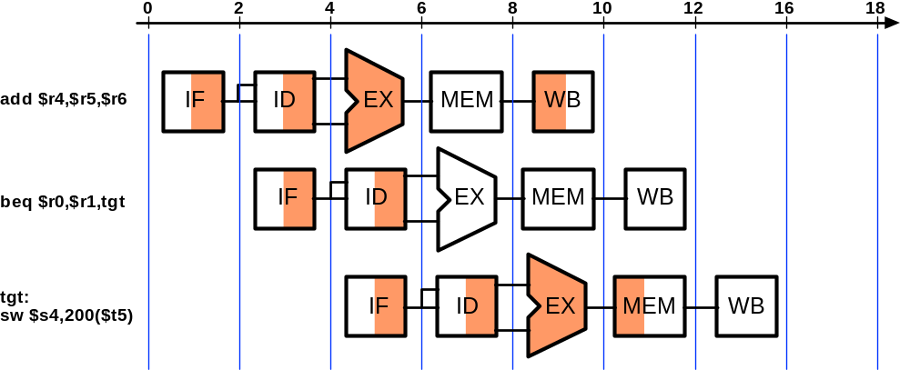
Control Hazard - Correct Prediction
Fetch assuming
branch taken

Slide 40
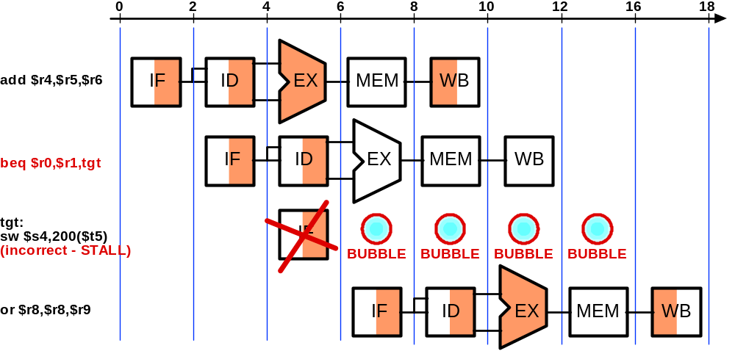
Control Hazard - Incorrect Prediction
“Squashed”
instruction

Slide 41
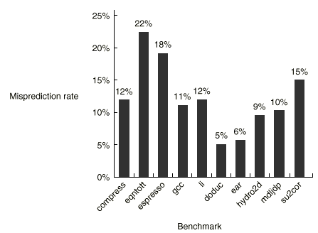

Profile-Based Compiler Branch
Misprediction Rates for SPEC92

Slide 42
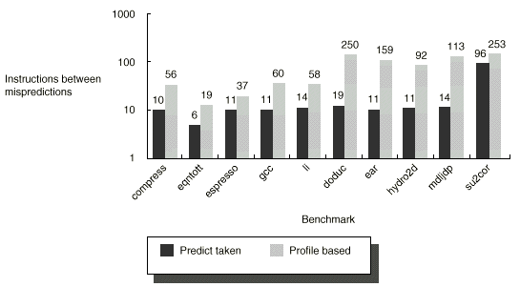

Slide 43
Pipeline Performance Example
Assume the following MIPS instruction mix:
What is the resulting CPI for the pipelined MIPS with forwarding and branch address calculation in ID stage when using a branch not-taken scheme?
CPI = Ideal CPI + Pipeline stall clock cycles per instruction
= 1 + stalls by loads + stalls by branches
= 1 + .3 x .25 x 1 + .2 x .45 x 1
= 1 + .075 + .09
= 1.165
Type Frequency
Arith/Logic 40%
Load 30% of which 25% are followed immediately by
an instruction using the loaded value
Store 10%
branch 20% of which 45% are taken

